Slide 1
Solving ML tasks with ML.NET, Azure ML Studio, scikit-learn Oleksandr Krakovetskyi CEO DevRain Solutions, Ph.D. CTO DonorUA Microsoft Regional Director fb.com/alex.krakovetskiy

Slide 2
What is ML.NET?
Ability to work with ML models in native .NET languages like C#, "without having to learn and use Python“.
Classification and clustering (e.g. text categorization and sentiment analysis), regression (e.g. forecasting and price prediction).
Works on any platform supporting 64-bit .NET Core, including Windows, Linux, and macOS.
https://github.com/dotnet/machinelearning/

Slide 3
What is ML.NET?
Ability to work with ML models in native .NET languages like C#, "without having to learn and use Python“.
Classification and clustering (e.g. text categorization and sentiment analysis), regression (e.g. forecasting and price prediction).
Works on any platform supporting 64-bit .NET Core, including Windows, Linux, and macOS.
https://github.com/dotnet/machinelearning/

Slide 4
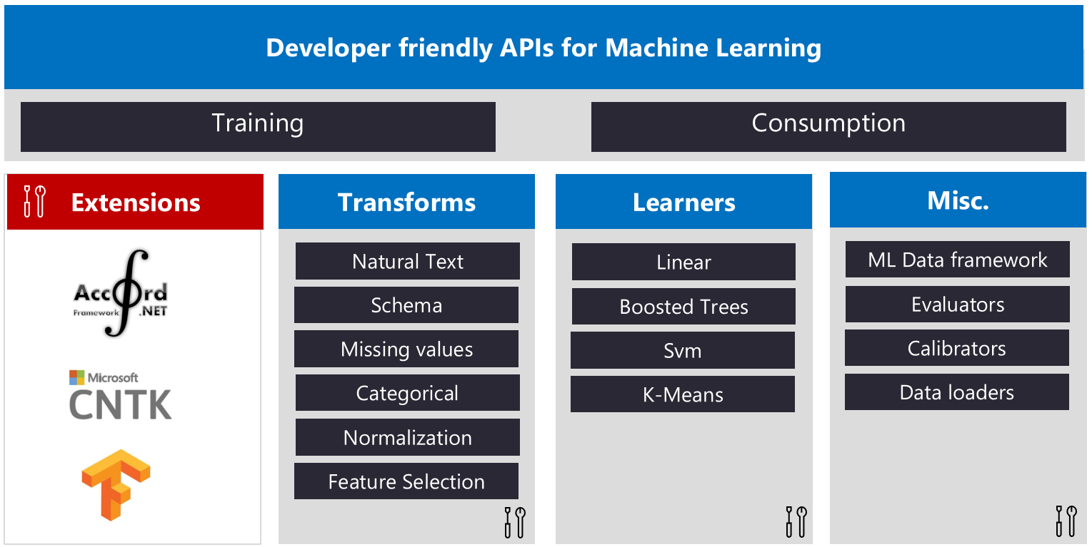
What is ML.NET?

Slide 5
ML.NET: Future Plans
ONNX support
Scale-out on Azure
Better GUI to simplify ML tasks
Integration with VS Tools for AI

Slide 6
What is scikit-learn?
Machine Learning in Python
Simple and efficient tools for data mining and data analysis
Accessible to everybody, and reusable in various contexts
Built on NumPy, SciPy, and matplotlib
Open source, commercially usable - BSD license
http://scikit-learn.org/stable/index.html

Slide 7

What is Azure Machine Learning Studio?
A GUI-based integrated development environment for constructing and operationalizing Machine Learning workflow on Azure.
https://studio.azureml.net/

Slide 8
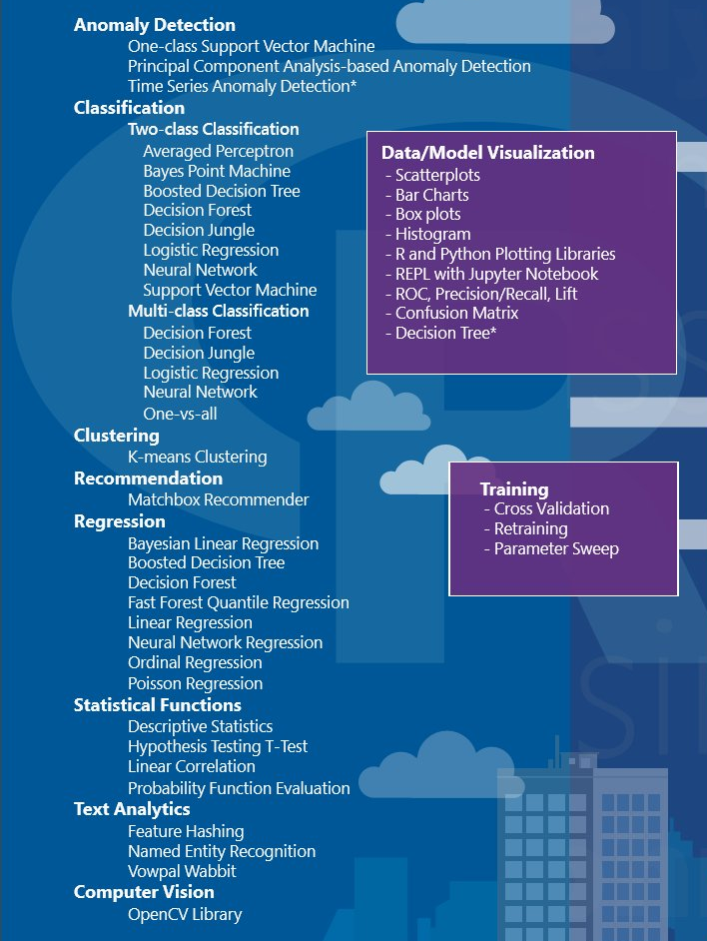
Azure ML Studio
Anomaly Detection
Classification
Clustering
Recommendation
Regression
Statistical Functions
Text Analytics
OpenCV Library

Slide 9
Demo

Slide 10

Q&A
Oleksandr Krakovetskyi
CEO DevRain Solutions
alex.krakovetskiy@donor.ua
@sashaeve
fb.com/alex.krakovetskiy

